Slide 1
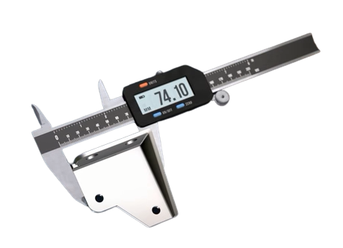
Limit, Fit, and Tolerance
Prepared by:
Er. Bibek Magar
BE in Automobile Engineering
IOE, Thapathali Campus
bibek.magar@thc.tu.edu.np

Slide 2
Introduction
In a mass scale production system, as number of components and number of assemblies are manufactured on mass scale, many a time it is difficult, and even not viable, to manufacture all parts under one roof. In this case, many manufacturers offload jobs to outsiders, sometimes even those situated in other parts of the country. Producing the exact size given by the designer in a drawing is a difficult task, especially in case of machining operations. To overcome this problem, the designer gives a range of limits to the basic size, within which he expects the finished size of the job offloaded by his factory. The assembly designer will finalize the limits depending upon the kind of fit required for the assembly of those components.
Dimensional variations occur due to the following reasons:
Variations in material properties during machining
Inaccuracies and errors in manufacturing machines
Human errors
If components are to be interchanged, they need to be manufactured to the same size, which is not possible in mass production. Hence, it becomes necessary to permit the operator, a small deviation from the exact size, which is not possible in the case of all components. At the same time, the deviated size should not affect the quality of the assembly. This sort of dimensioning is known as limit dimensioning. Various standard systems of limits and fits are followed by different countries based on the International Organization for Standardization (ISO) specifications.

Slide 3
Some Important Terminologies
Upper deviation hole
Tolerance hole
Lower deviation hole
Zero Line
Upper Limit hole
Lower Limit shaft
Lower Limit hole
Upper Limit shaft
Tolerance shaft
Upper deviation shaft
Lower deviation shaft

Slide 4
Fundamental Deviation of hole
Fundamental Deviation of shaft
50H8/d9
Basic Size
International Tolerance Grade of hole
International Tolerance Grade of shaft

Slide 5
Basic size: It is the size based on which the dimensional deviations are given.
Actual size: It is the size of the component by actual measurement after it is manufactured. It should lie between the two limits of size if the component is to be accepted.
Limits of size: These are the extreme permissible sizes within which the operator is expected to make the component, that is, maximum and minimum limits.
Maximum limit of size: It is the greater of the two limits of size.
Minimum limit of size: It is the smaller of the two limits of size.
Upper deviation: It is the algebraic difference between the maximum limit of size and its corresponding basic size.
Lower deviation: It is the algebraic difference between the minimum limit of size and its corresponding basic size.
Tolerance: It is the difference between the maximum limit and the minimum limit of size.
Zero line: In a graphical representation of the above terms, the zero line represents the basic size. This line is also called as the line of zero deviation.

Slide 6
There are twenty-five fundamental deviations in the BIS system, which are represented by letter symbols (capital letters for holes and small letters for shafts), that is, for holes, ABCD … Z excluding I, L, O, Q, and W.
I.T
F.D
Datum/ Zero Line
F.D = Fundamental Deviation
I.T = International Tolerance

Slide 7
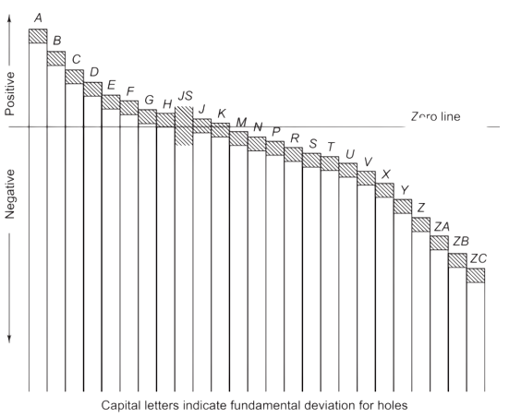

Slide 8
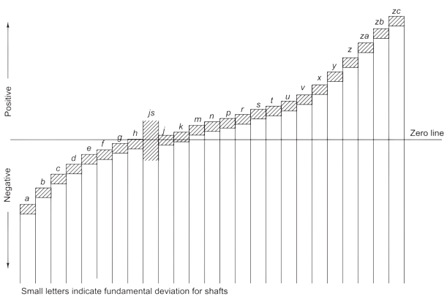

Slide 9
Types of Fit
Clearance fit: This fit always provides clearance. Here the tolerance zone of the hole will be above the tolerance zone of the shaft.
Interference fit: It is a fit that always provides interference. Here, the tolerance zone of the hole will be below the tolerance zone of the shaft.
Transition fit: It is a fit that may sometimes provide clearance and sometimes interference. When this class of fit is represented graphically, the tolerance zones of the hole and shaft will overlap each other.

Slide 10
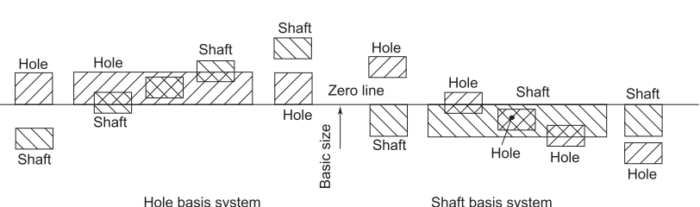
Hole basis system: A standard system of limits and fits, where the size of the hole is kept constant and the size of the shaft is varied to get the different classes of fits, is known as the hole basis system.
Shaft basis system: A standard system of limits and fits, where the size of the shaft is kept constant and variations are given to the hole for obtaining different classes of fits, is known as the shaft basis system.

Slide 11
Allowance: It is an intentional difference between maximum material limits of mating parts. It is a minimum clearance or maximum interference between mating parts.
Maximum Allowance: The positive difference between the maximum size of a hole and the minimum size of a shaft.
Minimum Allowance: The positive difference between the minimum size of a hole and the maximum size of a shaft
Minimum Allowance | Maximum Allowance | Fit
Positive | Positive | Clearance
Negative | Negative | Interference
Negative | Positive | Transition

Slide 12

Solved Examples:

Slide 13
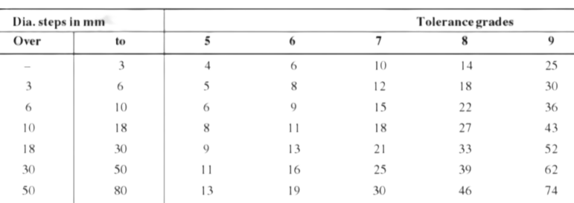
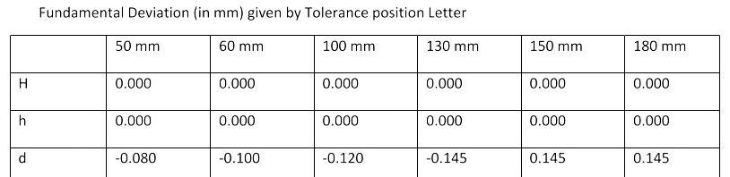
Q1) In freehand sketch, make the complete fit analysis of the given fit symbol, 50H8/d9.(indicate the type of fit ,the allowance, upper and lower limit , upper and lower deviation, and Hole of Shaft basis system)
Given:
Basic Size (BS) = 50
The given fit is a hole basis system
Upper Deviation of hole = ULH - BS
= 50.039 – 50
= 0.039
Hole
Shaft
Lower Deviation of hole = LLH - BS
Fundamental Deviation (FD)_{H} =
0
Fundamental Deviation (FD)_{S} =
- 0.080
= 50 – 50
= 0
International Tolerance(IT)_{H} =
0.039
International Tolerance(IT)_{S} =
- 0.062
Upper Limit Hole (ULH) = BS + (FD)_{H} + (IT)_{H}
Upper Limit Shaft (ULS) = BS + (FD)_{S}
= 50 + 0 + 0.039
= 50.039
= 50 – 0.08
= 49.92
Upper Deviation of shaft = ULS - BS
= 49.92 -50
= -0.08
Lower Limit Hole (LLH) = BS + (FD)_{H}
Lower Limit Shaft (LLS) = BS + (FD)_{S} + (IT)_{S}
= 50 + 0
= 50
= 50 - 0.08 – 0.062
= 49.858
Lower Deviation of shaft = LLS - BS
= 49.858 -50
= - 0.142
Max. Allowance = ULH – LLS = 50.039 – 49.858 = 0.181 (+ve )
Min. Allowance = LLH – ULS = 50 – 49.92 = 0.181 (+ve )
Hence, the given system is a clearance fit.

Slide 14
0.039
Zero line
0.142
50.039
50
0.08
49.92
49.858

Slide 15
Q2) In freehand sketch, make the complete fit analysis of the given fit symbol, 100 H7/s6.(indicate the type of fit , upper and lower limit , and Hole of Shaft basis system)
Given, Basic Size (BS) = 100
The given fit is a Hole basis system.
Hole
Shaft
Fundamental Deviation of Hole (FD)_{H} = 0
Fundamental Deviation of Shaft (FD)_{S} = 0.071
International Tolerance of Hole (IT)_{H} = 0.035
International Tolerance of Shaft(IT)_{S} = 0.022
Upper Limit Hole (ULH) = BS + (FD)_{H} + (IT)_{H}
Upper Limit Shaft (ULS) = BS + (FD)_{S} + (IT)_{S}
= 100 + 0 + 0.035
= 100.035
= 100 + 0.071 + 0.022
= 100.093
Lower Limit Hole (LLH) = BS + (FD)_{H}
Lower Limit Shaft(LLS) = BS + (FD)_{S}
= 100 + 0
= 100
= 100 +0.071
= 100.071
Minimum Allowance = LLH – ULS = 100 – 100.093 = - 0.093 (-)ve
Maximum Allowance = ULH – LLS = 100.035 – 100.071 = - 0.036 (-)ve
Hence, the given system is an Interference fit.

Slide 16
0.022
0.035
100.093
100.035
100.071
100

Slide 17
Q3) In freehand sketch, make the complete fit analysis of the given fit symbol, 60 S6/h12.(indicate the type of fit , upper and lower limit , and Hole of Shaft basis system)
Given, Basic Size (BS) = 60
The given fit is a Shaft basis system.
Hole
Shaft
Fundamental Deviation of Hole (FD)_{H} = - 0.042
Fundamental Deviation of Shaft (FD)_{S} = - 0
International Tolerance of Hole (IT)_{H} = - 0.019
International Tolerance of Shaft(IT)_{S} = - 0.3
Lower Limit Hole (LLH) = BS + (FD)_{H} + (IT)_{H}
Lower Limit Shaft (LLS) = BS + (FD)_{S} + (IT)_{S}
= 60 – 0.042 – 0.019
= 59.939
= 60 – 0 – 0.3
= 59.7
Upper Limit Hole (ULH) = BS + (FD)_{H}
Upper Limit Shaft(ULS) = BS + (FD)_{S}
= 60 – 0.042
= 59.958
= 60 - 0
= 60
Minimum Allowance = LLH – ULS = 59.939 – 60 = - 0.061 (-)ve
Maximum Allowance = ULH – LLS = 59.958 – 59.7 = 0.258 (+)ve
Hence, the given system is an Transition fit.

Slide 18
0.3
0.019
59.958
60
59.939
59.7

Slide 19


